Slide 1

Sensors
Module
Rohit Kumar

Slide 2
Contents
Title | Page
What is sensor?
Types of sensors
IR Sensor
Ultrasonic Sensor

Slide 3
What is Sensor?
A sensor is a device that measures a physical quantity and converts it into a signal which can be read by an observer or by an instrument.
Sensors are used in everyday objects such as touch-sensitive elevator buttons (tactile sensor) and lamps which dim or brighten by touching the base.
Applications include cars, machines, aerospace, medicine, manufacturing and robotics.

Slide 4
IR Sensor
Ultrasonic Sensor
Types of Sensors

Slide 5
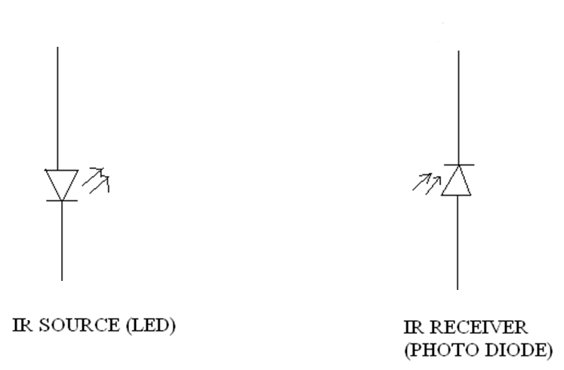
IR sensor basically consist an IR LED and a Photodiode, this pair is generally called IR pair or Photo coupler. IR sensor work on the principal in which IR LED emits IR radiation and Photodiode sense that IR radiation. Photodiode resistance changes according to the amount of IR radiation falling on it, hence the voltage drop across it also changes and by using the voltage comparator (like LM358) we can sense the voltage change and generate the output accordingly.
IR Sensor

Slide 6
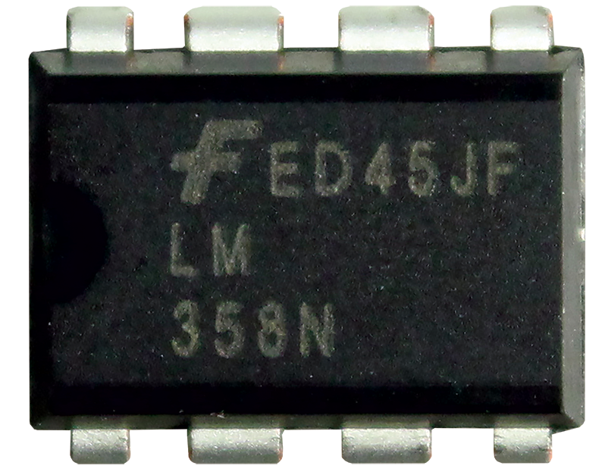
Voltage Comparator
A comparator is a device which compares two voltages or currents and switches its output to indicate which is larger.
Comparator is On-Amp.

Slide 7
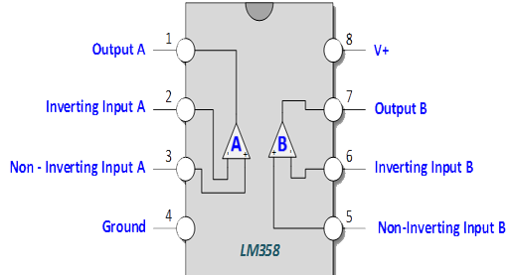
Pin Diagram

Slide 8
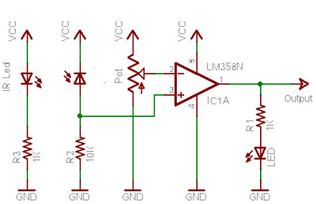
Circuit Diagram

Slide 9
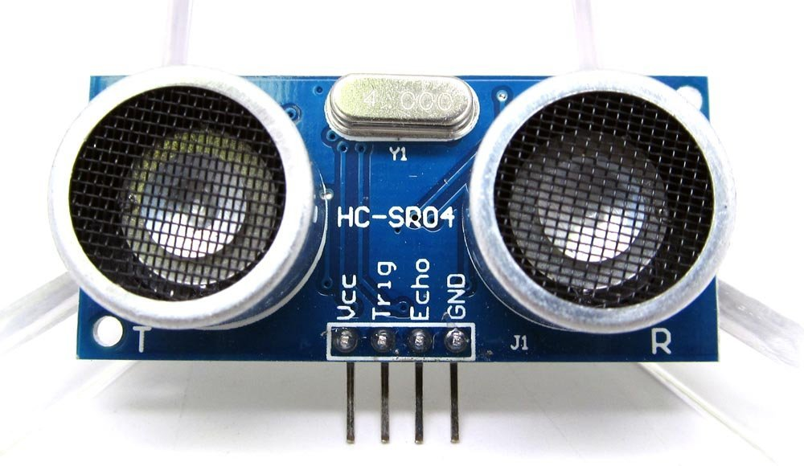
Ultrasonic Sensor
Ultrasonic transmitter emitted an ultrasonic wave in one direction, and started timing when it launched. Ultrasonic spread in the air, and would return immediately when it encountered obstacles on the way. At last, the ultrasonic receiver would stop timing when it received the reflected wave. As Ultrasonic spread velocity is 340m / s in the air, based on the timer record t, we can calculate the distance (s) between the obstacle and transmitter, namely: s=340t/ 2, which is so- called time difference distance measurement principle.

Slide 10
Electrical parameters
Electrical Parameters | HC-SR04 Ultrasonic Module
Operating Voltage | DC-5V
Operating Current | 15mA
Operating Frequency | 40KHZ
Farthest Range | 4m
Nearest Range | 2cm
Measuring Angle | 15 Degree
Dimensions | 45*20*15mm

Slide 11
Thank You !
Contact US
Nitin Sinha
nitin.sinha@goSigmaWay.com
+1 727-394-4375
+91 7838188809
Debjani Mitra
debjani.mitra@goSigmaWay.com
+1 952-583-3449
+91 9339555636
Rohit Kumar
rohit.kumar@sigmaway.us
+91 7982577830
+91 7838021754

